Slide 1


FACIE SENTINEL
TRACK :
Cybersecurity
PROBLEM STATEMENT :
Design and build an automated tool that helps developers or security teams detect, prevent, or respond to API security risks in real time.
TEAM NAME :
Sentinel ARK
IDEA TITLE :
Facie Sentinel
Notes:
Fill in the Problem Statement field with the exact text released at hackathon start before final submission.

Slide 2
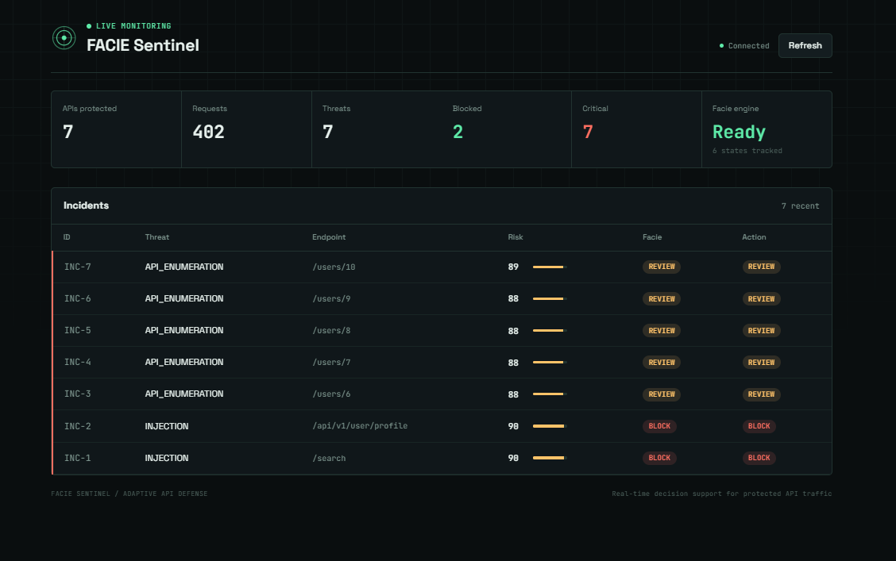
SLIDE 2 : PROPOSED SOLUTION
Facie Sentinel watches every API request in real time and returns a confidence-scored risk verdict the instant it happens.
Every flag ships with a plain-English reason — never a black-box number — so a human can trust or challenge it immediately.
The analyst keeps final control: allow the request, or keep it blocked, in one click from the live dashboard.
Built for teams who face real API-borne attacks — credential stuffing, bot scraping, injection attempts, checkout fraud — but can't staff a 24/7 SOC to watch for them.
INIT'26 • FACIE-SENTINEL • CYBERSECURITY TRACK
Notes:
Position this as the middle path between rigid static rules and slow manual review.

Slide 3
SLIDE 3 : TECHNICAL APPROACH
1
Ingest
Sits in front of the protected API and observes every incoming request as it arrives.
2
Facie Scoring Engine
Weighs request-pattern signals — rate, origin, payload shape, auth anomalies — into one confidence-weighted risk score.
3
Reasoning Layer
Converts the score's contributing signals into a plain-English "why flagged" explanation, not just a number.
4
Decision Layer
Auto-enforces at configurable thresholds; routes mid-confidence incidents to a one-click human Allow / Block queue.
5
Feedback Loop
Analyst decisions are logged and fed back in, so future scoring keeps improving.
INIT'26 • FACIE-SENTINEL • CYBERSECURITY TRACK
Notes:
Swap in your real stack details before submitting — kept generic since exact tooling wasn't specified.

Slide 4
SLIDE 4 : HOW IT WORKS ? (USER FLOW)
1
2
3
4
5
Request Hits API
Facie Scores It
Risk Explained
Analyst Decides
Outcome Logged
INIT'26 • FACIE-SENTINEL • CYBERSECURITY TRACK
Notes:
Walk the loop once, slowly: request, score, explain, decide, learn.

Slide 5
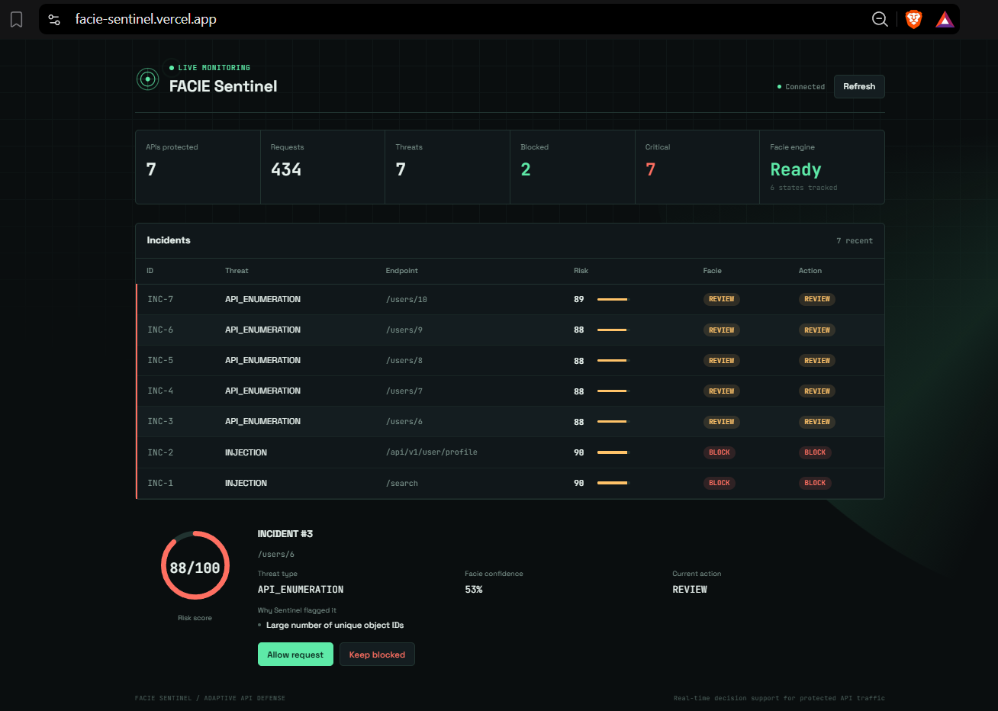
SLIDE 5 : PROJECT SNAPSHOTS
Live at facie-sentinel.vercel.app
INIT'26 • FACIE-SENTINEL • CYBERSECURITY TRACK
Notes:
Swap the illustrative rows and the side panel for real screenshots of your working demo before you submit.

Slide 6
SLIDE 6 : FEASIBILITY / VIABILITY AND IMPACT
FEASIBILITY
VIABILITY
Core Facie scoring engine and live dashboard already built and deployed at facie-sentinel.vercel.app.
Sits in front of existing APIs as a lightweight layer — no exotic infrastructure required to adopt.
Global API security spend is projected to grow from ~$1.2B (2026) to ~$8.9B by 2034 — a 28.5% CAGR (Fortune Business Insights).
API surface area is growing faster than security teams can hire, which is exactly the gap Facie Sentinel targets.
IMPACT
Fewer false positives than static rule-based tools — real users stop getting wrongly blocked.
Fewer missed threats than manual-only review, at a fraction of the response time.
Gives teams without a dedicated SOC a real-time, explainable line of defense for their APIs.
INIT'26 • FACIE-SENTINEL • CYBERSECURITY TRACK
Notes:
Cite the market number once, don't linger. Impact bullets should stay concrete and comparative.

Slide 7
SLIDE 7 : REFERENCES & REPOSITORY LINKS
Fortune Business Insights — API Security Market Size, Share & Industry Report (2026).
Prototype Link — https://facie-sentinel.vercel.app/
Repository Link - https://github.com/ShivKum06/Facie-Sentinel
INIT'26 • FACIE-SENTINEL • CYBERSECURITY TRACK
Notes:
Add your real citations — datasets, libraries, or papers your build draws on.

